Slide 1
Develop a blockchain-based system for botanical traceability of Ayurvedic herbs
CSE7302- University Project
Review-2
Batch Number:CSE_195
Under the Supervision of,
Ms. Sharanya Salian
Associate Professor
School of Computer Science and Engineering
Presidency University
20221CSE0671 | Gurukiran
20221CSE0706 | Rohith H R
20221CSE0723 | Sudeep
Roll Number | Student Name
Name of the Program: University Project
Name of the HoD: Dr.Blessed Prince
Name of the Program Project Coordinator: Dr. Muthuraju V
Name of the School Project Coordinators: Dr. Sampath A K , Dr. Geetha A

Slide 2
Problem Statement Number : SIH25001
Organization: Ministry of Health and Family Welfare (MoHFW), Government of India
Category : Software
Problem Description:
Ayurvedic medicines are formulated using medicinal herbs whose quality, authenticity, and origin play a crucial role in ensuring therapeutic effectiveness and patient safety. However, the current Ayurvedic herbal supply chain lacks a reliable and transparent traceability mechanism to track botanical materials from their source to the final product. Most records related to herb collection, cultivation, processing, and distribution are maintained in manual or centralized systems, making them prone to data manipulation, errors, and information loss.

Slide 3
Content
Objectives
Background and Related work for title Selection
Analysis of Problem Statement
Innovation or Novel Contributions
Timeline of the Project
References

Slide 4
Content (continuation)..
Objective :
Blockchain technology operates as a decentralized ledger that records transactions across multiple computers. In the context of Ayurvedic herbs, it enables the tracking of each herb's journey from cultivation to the end consumer, ensuring transparency, authenticity, and traceability throughout the supply chain. This technology provides an immutable and secure record of each step in the supply chain, helping to prevent counterfeiting, ensure quality control, and enhance consumer trust in the authenticity of Ayurvedic products.
Background and Related Work
Secure blockchain records ensure authenticity, quality, and accurate origin verification across the supply
chain. This approach enhances transparency, prevents adulteration, and builds trust among all stakeholders.

Slide 5
Content (continuation)..
Analysis of the Problem Statement :.
The Ayurvedic herbal supply chain is complex and relies on centralized or manual records, leading to low transparency and data tampering.
Lack of secure traceability results in adulteration, misidentification of herbs, and false origin claims.
There is a need for a decentralized, tamper-proof system to ensure authenticity, quality, and trust across the supply chain.
Innovations / Novel Contributions :
Proposes a blockchain-based traceability system specifically designed for Ayurvedic botanical supply chains.
Ensures tamper-proof and transparent recording of herb-related data from collection to final product.
Improves authenticity verification and adulteration prevention without relying on centralized control.
Provides a trustworthy framework for manufacturers, regulators, and consumers.

Slide 6
Analysis of Problem Statement
Frontend | React.js
Backend | Node.js with Express.js
Blockchain | Ethereum (Test Network)
Smart Contracts | Solidity
Blockchain API | Web3.js
Database | MongoDB
Geo-Tagging | Google Maps API
Security | JWT
QR Code | QR Code Generator
Blockchain Dev Tool | Truffle

Slide 7
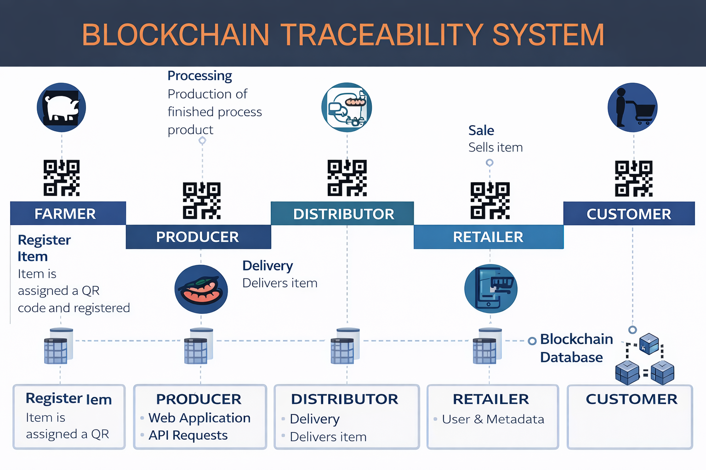
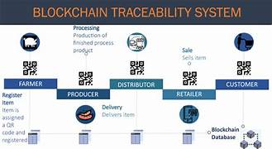
System Design and Architecture

Slide 8
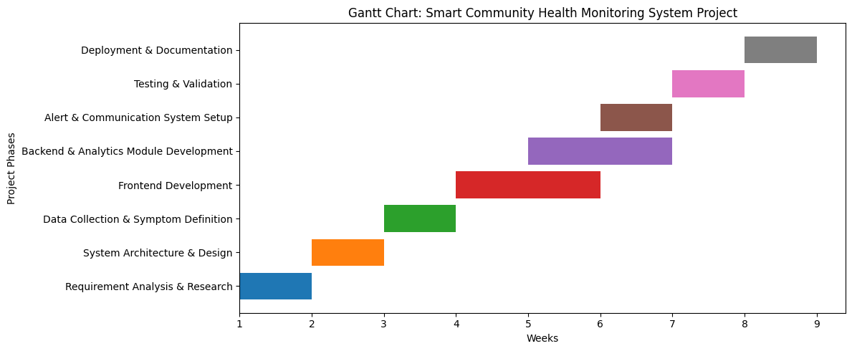
Timeline of the Project (Gantt Chart)

Slide 9
References (IEEE Paper format)
S.Nakamoto , “Bitcoin: A Peer-to-Peer Electronic Cash System,” 2008. [Online]. Available: https://bitcoin.org/bitcoin.pdf
M. Casino, T. K. Dasaklis, and C. Patsakis, “A systematic literature review of blockchain-based applications: Current status, classification and open issues,” Telecommunications Systems, vol. 68, no. 3, pp. 1–17, 2019.
A. Reyna, C. Martín, J. Chen, E. Soler, and M. Díaz, “On blockchain and its integration with IoT: Challenges and opportunities,” Future Generation Computer Systems, vol. 88, pp. 173–190, 2018.
K. Salah, M. H. U. Rehman, N. Nizamuddin, and A. Al-Fuqaha, “Blockchain for AI: Review and open research challenges,” IEEE Access, vol. 7, pp. 10127–10149, 2019.
T. Lin, H. Wang, X. Pei, and C. Wang, “Food safety traceability system based on blockchain and IoT technology,” IEEE Access, vol. 7, pp. 20698–20707, 2019.
P. K. Singh and S. Kim, “Secure and transparent supply chain management using blockchain technology,” International Journal of Advanced Computer Science and Applications, vol. 10, no. 5, pp. 1–8, 2019.

Slide 10


